Slide 1
Agile – Retrospective Meetings

Slide 2
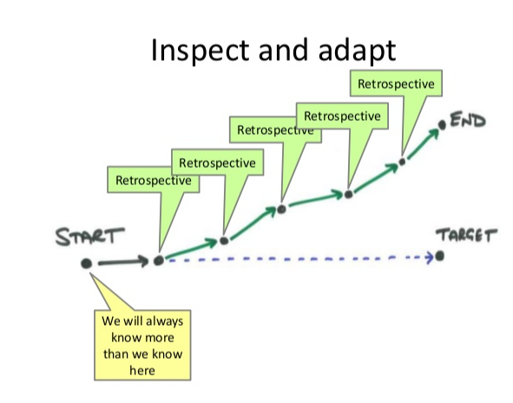
Retrospective Meeting
Why to do Retrospective Meeting (Inspection & Adaption):-
Retrospective Meeting is a practice used by teams to reflect on their way of working, and to continuously become better in what they do.
The whole team attends the retrospective meeting, where they “inspect” how the iteration (sprint) has been done, and decide what and how they want to “adapt” their processes to improve.

Slide 3
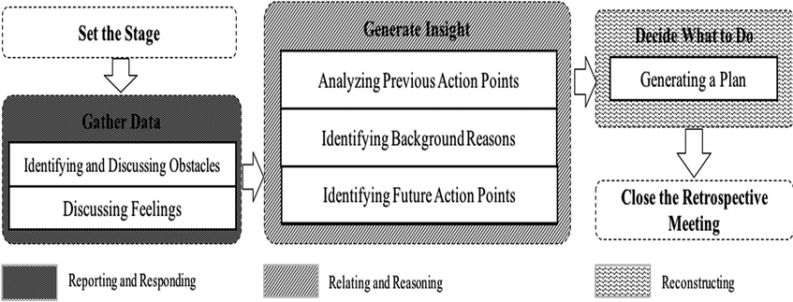
Retrospective Meeting – Process Flow
Steps performed during Retrospective Meeting are:- Whole Sprint team should conduct the retrospective Meeting and its duration must be 1 hour per week i.e. 2 hrs. for 2 week sprint.
Reasons to have retrospective Meetings are:-
Create transparency and trust
Boost team spirit & Empower team members
Discover risks early
Learn and adapt

Slide 4
Retrospective Meeting Processes - ITTO
Occurrence | Input(s) | Tools | Output(s)
At Sprint End | Input gathered from team members during a Retrospective Meetings. Retrospection Items (Matrices like Burn Down Chart, Velocity etc.) gathered in current Sprint. | VSTS Sprint work item Sprint rating work item | Action Items
At Release End | Input gathered from team members during a Retrospective Meetings. Retrospection Items (Matrices like Burn Down Chart, Velocity etc.) gathered in current Sprint. | VSTS Sprint work item Sprint rating work item | Action Items
At Project End | Input gathered from team members during a Retrospective Meetings. Retrospection Items (Matrices like Burn Down Chart, Velocity etc.) gathered in current Sprint. | VSTS Sprint work item Sprint rating work item | Action Items
To discuss any Problematic Area | Problem/Incident details | VSTS | Resolution
Whole Sprint team should conduct the retrospective Meeting.
Duration of Retrospective Meeting must be 1 hour per week i.e. 2 hrs. for 2 week sprint.

Slide 5
Retrospective Meeting Techniques
Techniques to conduct a Retrospective Meeting:- The retrospective facilitator (often the Scrum master) should use different techniques to make the retrospectives interesting. We would recommend below Retrospective Techniques to follow:-
Liked, learned, lacked, longed for (4 L’s)
Stop, Start, Continue
Mad, Sad, Glad
One Word Retrospective
Tools recommended for conducting distributed teams Retrospective Meeting :-
There are various tools which can be used to conduct Retrospective meeting. In our organization, we use a collaboration tool called WebEx from Cisco. So we would recommend the same. Though we also have some freeware tools available like Slack, Skype and FunRetro etc.
Important points to be discussed in Sprint Retrospection are:-
What worked well (each member of the team should answer this)
What did not worked well (again each member of the team should be involved)
Actions that can improve the process/deliverable

Slide 6
Retrospective
Process of deciding Actions of any Retrospection meetings: -
The main goal of the retrospective is to identify what actions must be taken in the next iteration. From the ideas discussed, the team should determine measurable actions that they can implement according to the priority.
A successful retrospective will generate outcomes that are quantifiable actions. One has to generate a list of commitments for further iterations that will improve the team’s performance in the long term.
Visibility of Retrospection meetings Actions:-
Action points which are decided in any Retrospective Meeting are assigned to either team or any agreed team members to take care in future Sprints.
To assure that actions from a retrospective are done, they can be brought into the planning game, and made visible by putting them on the planning board. We would recommend User stories to be created to plan and track the bigger improvements.
Starting of The Next Retrospective:-
In the next retrospective, the Scrum Master brings the list of ideas generated at the previous retrospective--both the ideas chosen to be worked on and those not. These can help jump-start discussion for the next retrospective.

